Slide 1
Easy Fixes?
Does Yelp data suggest any easy ways for restaurants to increase their star ratings?
Group L
Erica Briga
Anne-Lycia ten Cate
Yujia Liu
Wen Ren
Lu Wang

Slide 2
Association
noise level
wi-fi
price level
kids
waiter
take-out
outdoor-seating
parking
good for
star ratings
Prediction
Logistic regression
SVM
K Nearest Neighbours
Decision Tree
Random Forest

Slide 3
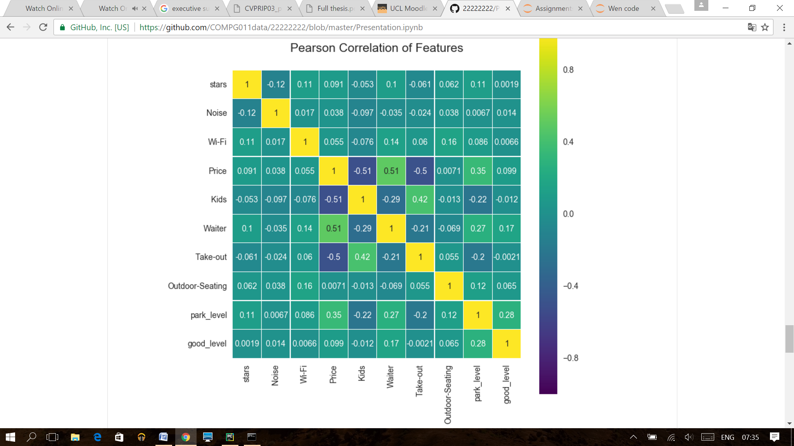

Slide 4
Feature Dependencies

Slide 6
Correlation with star ratings

Slide 7
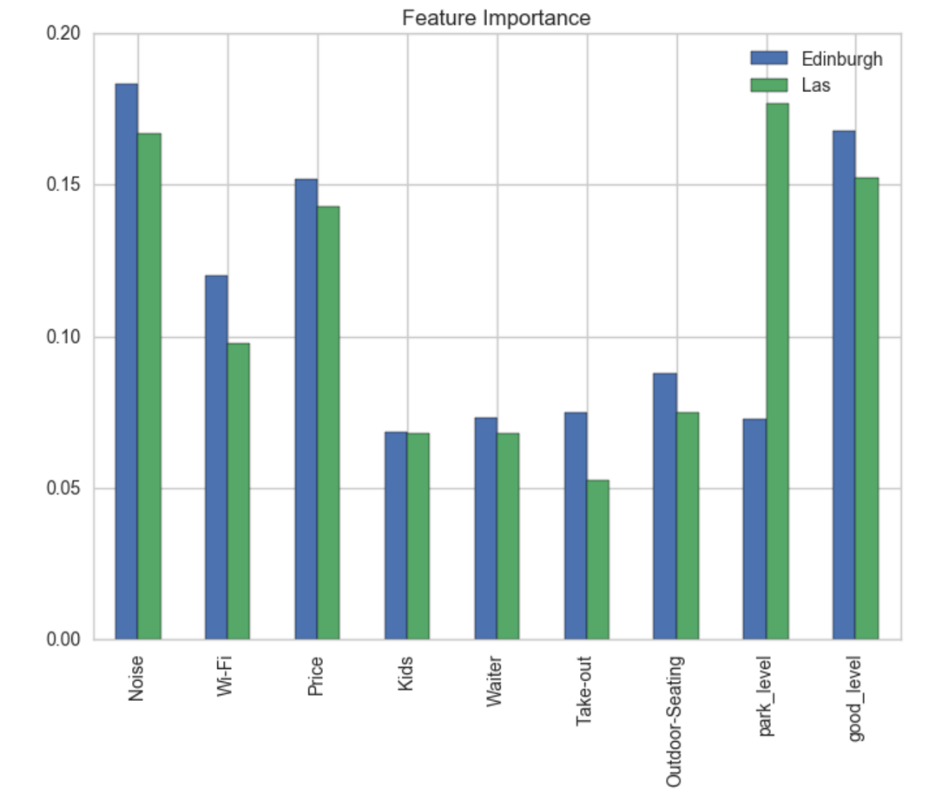
Random Forest

Slide 8
Conclusions
Easy Fixes?
Noise
Parking (Las Vegas)
Good for
Price

